Slide 1
COMS E6998: Microservices and Cloud Applications Lecture 5: Idempotency, Conditional Execution, Orchestration, Pub/Sub, API GW
Dr. Donald F. Ferguson
dff9@columbia.edu

Slide 2
Questions? Comments?

Slide 3
Development Methodology Design Docs Project Submission Requirements

Slide 4
Agile Development
Traditional “Waterfall” Methodology
Design seems to be missing?

Slide 5
Observations
Weinberg's Second Law: “If builders built buildings the way programmers wrote programs, then the first woodpecker that came along would destroy civilization.”
Sr. Celestina: “If you cannot write it down, you do not understand it.”
“it is a custom More honor'd in the breach than the observance” Hamlet Act 1, scene 4, 7–16
Agile Manifesto (http://agilemanifesto.org/):
Individuals and interactions over processes and tools
Working software over comprehensive documentation
Customer collaboration over contract negotiation
Responding to change over following a plan
Also, I want to help you build your “soft skills.”
Presentations
Elevator Speeches.
Project demos/reviews.

Slide 6
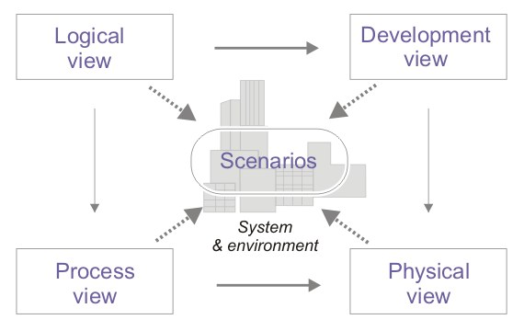
4+1 architectural view model http://en.wikipedia.org/wiki/4%2B1_architectural_view_model

Slide 7
The Architecture Views http://en.wikipedia.org/wiki/4%2B1_architectural_view_model
Logical view : The logical view is concerned with the functionality that the system provides to end-users. UML Diagrams used to represent the logical view include Class diagram, Communication diagram, Sequence diagram.^{[2]}
Development view : The development view illustrates a system from a programmer's perspective and is concerned with software management. This view is also known as the implementation view. It uses the UML Component diagram to describe system components. UML Diagrams used to represent the development view include the Package diagram.^{[2]}
Process view : The process view deals with the dynamic aspects of the system, explains the system processes and how they communicate, and focuses on the runtime behavior of the system. The process view addresses concurrency, distribution, integrators, performance, and scalability, etc. UML Diagrams to represent process view include the Activity diagram.^{[2]}
Physical view : The physical view depicts the system from a system engineer's point of view. It is concerned with the topology of software components on the physical layer, as well as the physical connections between these components. This view is also known as the deployment view. UML Diagrams used to represent physical view include the Deployment diagram.^{[2]}
Scenarios : The description of an architecture is illustrated using a small set of use cases, or scenarios which become a fifth view. The scenarios describe sequences of interactions between objects, and between processes. They are used to identify architectural elements and to illustrate and validate the architecture design. They also serve as a starting point for tests of an architecture prototype. This view is also known as use case view

Slide 8
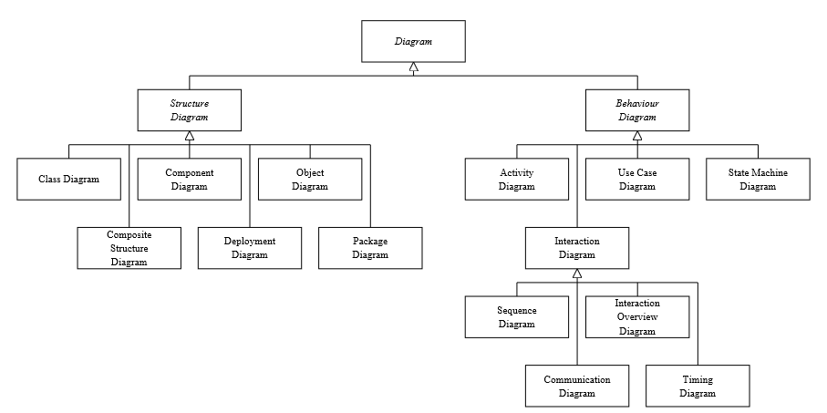
Some Diagrams http://www.agilemodeling.com/essays/umlDiagrams.htm

Slide 9
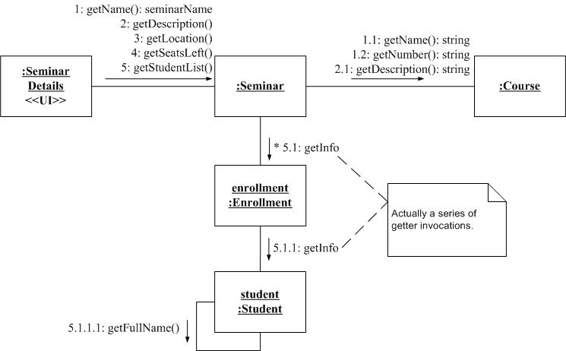
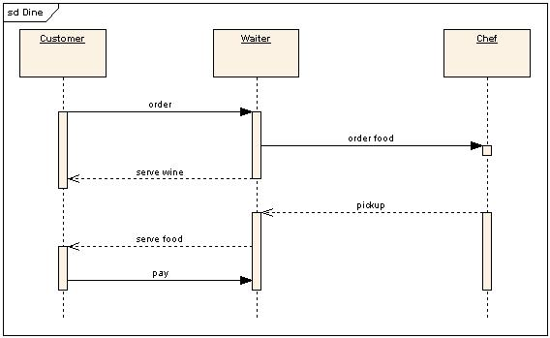
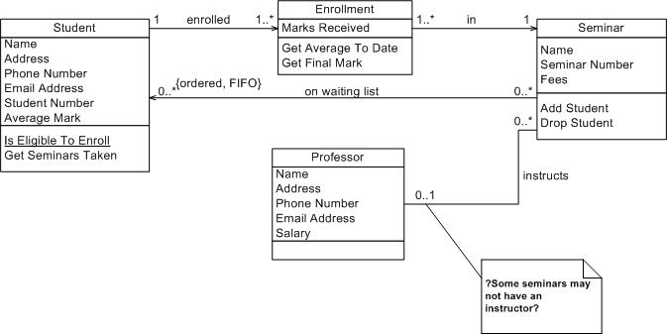
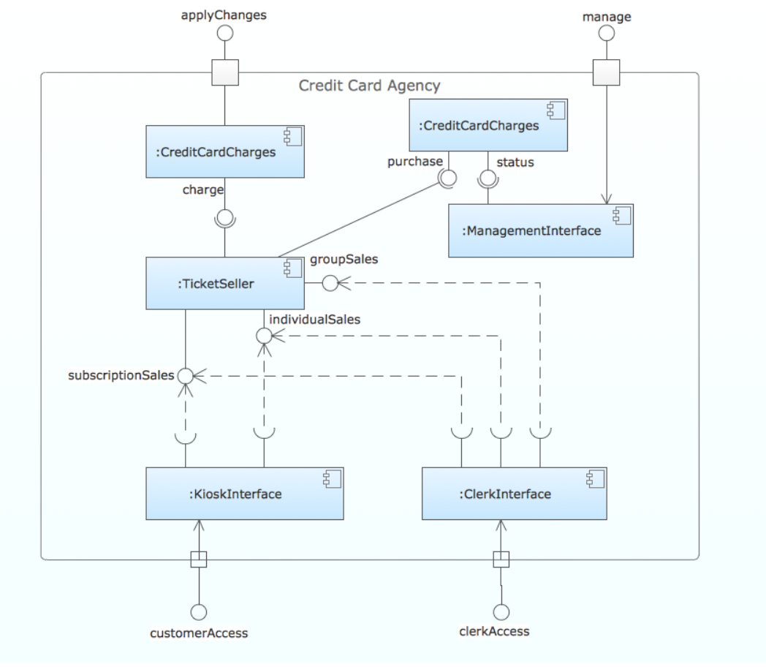
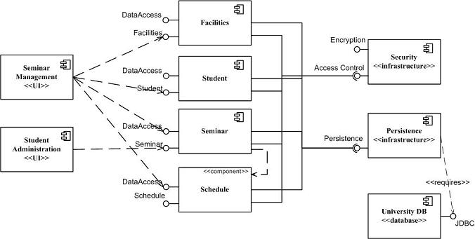
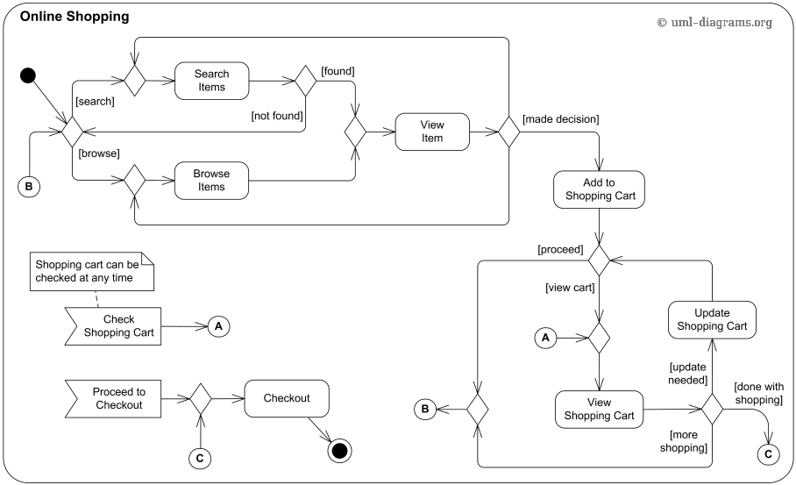
Some Diagrams
Communication Diagram
Class Diagram
Sequence Diagram
Component Diagram
Component Diagram
Activity Diagram

Slide 10
Application to Project Submissions
Communication Diagram
Class Diagram
Sequence Diagram
Component Diagram
Component Diagram
Activity Diagram

Slide 11
User Stories
User stories are short, simple descriptions of a feature told from the perspective of the person who desires the new capability, usually a user or customer of the system. They typically follow a simple template: (https://www.mountaingoatsoftware.com/agile/user-stories)
As a <type of user>, I want <some goal> so that <some reason>.
Example user stories (http://www.agilemodeling.com/artifacts/userStory.htm)
Students can purchase monthly parking passes online.
Parking passes can be paid via credit cards.
Parking passes can be paid via PayPal.
Professors can input student marks.
Students can obtain their current seminar schedule.
Students can order official transcripts.
Students can only enroll in seminars for which they have prerequisites.
Transcripts will be available online via a standard browser

Slide 12
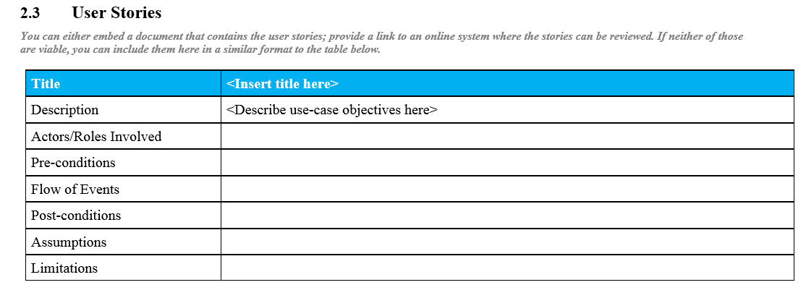
Agile Development and User Stories

Slide 13
Documenting API Example (We will use Swagger and Swagger Editor)
URI | https://mysite.com:3911/api/members/{id}
HTTP verb | PUT
Parameters | id : Card number of the member.
Body | name : Name of the member. email : Email adress of the member. langage : Langage used by member (Fr_CA ou En_US)
Sample body | { "name":"Mario Cardinal", "email":“mcardinal@mariocardinal.com", "language":"fr_CA" }
Success Response | Status Code: 204 No Content
Error Response | Status Code: 400 Bad Request, Body: {"Error Code":"..."} Status Code: 401 Unauthenticated, see WWW-Authenticate value in header Status Code: 403 Forbidden Status Code: 404 Not Found Status Code: 429 Too Many Requests, see Retry-After value in header Status Code: 500 Internal Server Error Status Code: 503 Service Unavailable
Error Code | 10: Inactive member 20: Denied access member 110: Database issues, Retry later

Slide 14
Documenting API Example (We will use Swagger and Swagger Editor)
URI | https://mysite.com:3911/api/members/{id}
HTTP verb | PUT
Parameters | id : Card number of the member.
Body | name : Name of the member. email : Email adress of the member. langage : Langage used by member (Fr_CA ou En_US)
Sample body | { "name":"Mario Cardinal", "email":“mcardinal@mariocardinal.com", "language":"fr_CA" }
Success Response | Status Code: 204 No Content
Error Response | Status Code: 400 Bad Request, Body: {"Error Code":"..."} Status Code: 401 Unauthenticated, see WWW-Authenticate value in header Status Code: 403 Forbidden Status Code: 404 Not Found Status Code: 429 Too Many Requests, see Retry-After value in header Status Code: 500 Internal Server Error Status Code: 503 Service Unavailable
Error Code | 10: Inactive member 20: Denied access member 110: Database issues, Retry later
Use Swagger to document APIs.

Slide 15
Top-Level Design Specification
Comments
I have presented a very systematic version of TLDS content.
All development projects should do some flavor of this approach, ideally simple and living/dynamic.
Just want to give you a feel for the types of things you can include in your TLDS, but you only need a really simple version.
Use common sense.
For your TLDS
Definitely define, prioritize and implement simple user stories.
You do not need to use UML, but should use some of the concepts.
Some useful diagrams/artifacts
Swagger API document.
Component diagram.
Class diagram documenting the logical datamodels/ resource models for components.
Some sequence diagrams showing end-to-end flows and Lambda functions in flows.
Why am I asking you to do this?
Documenting and presenting user stories, APIs and designs is a crucial career skill.
Learning the basic methodology is essential to converting unclear business requirements into a solution that satisfies both engineering and business stakeholders.
I purposely give you unclear specifications to force you to THINK and apply methodology.
The grade is based on the “correct answer,” but because the request is unclear, you use the methodology to define your correct answer.

Slide 16
API Management API Gateway

Slide 17
API Management

Slide 18
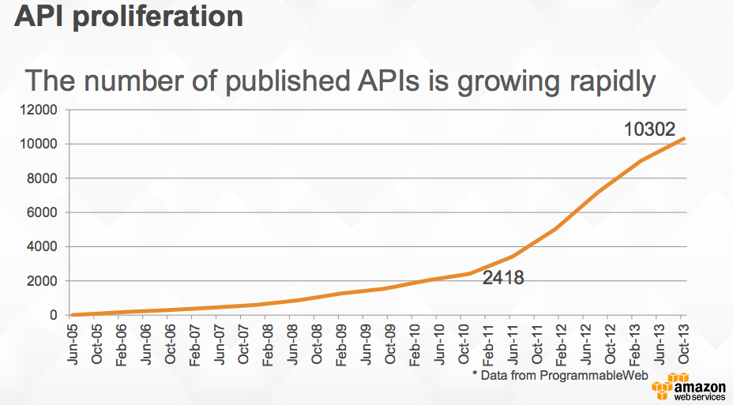
API Proliferation (https://www.slideshare.net/AmazonWebServices/build-and-manage-your-apis-with-amazon-api-gateway)

Slide 19
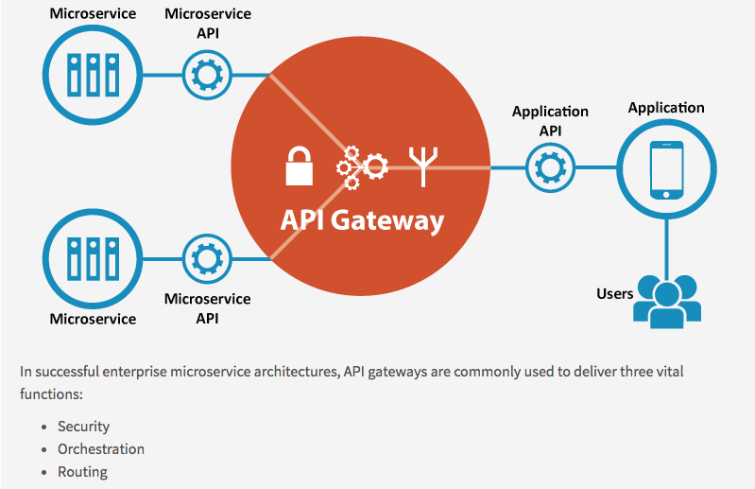
API Gateway/API Management/API Strategy
http://www.apiacademy.co/

Slide 20
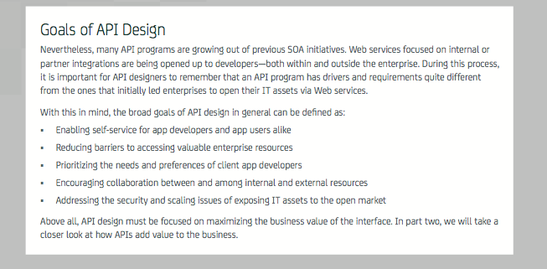
API Design/Strategy (https://www.ca.com/content/dam/ca/us/files/ebook/api-strategy-and-architecture-a-coordinated-approach.pdf)

Slide 21
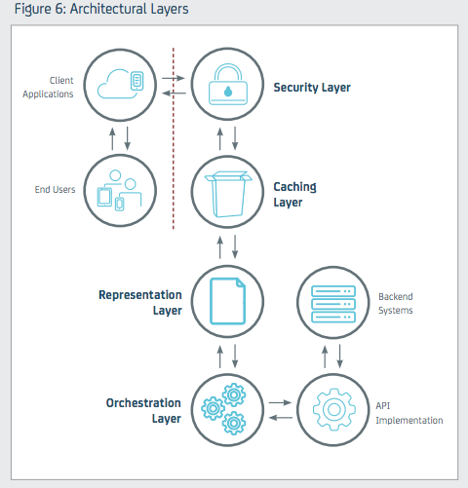
Architecture Layers

Slide 22
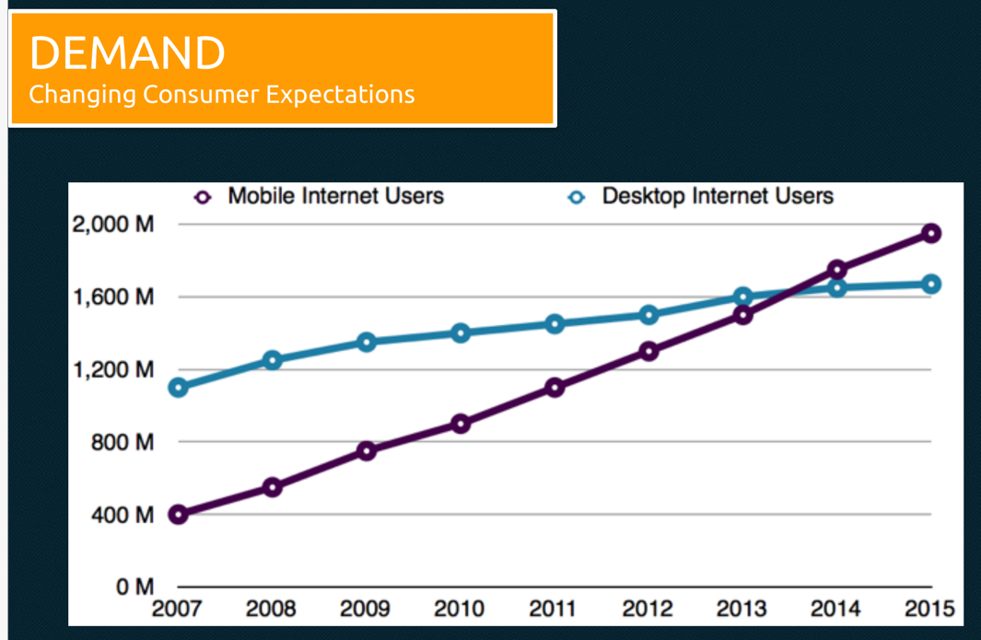
https://www.slideshare.net/mulesoft/welcome-to-the-api-economy-developing-your-api-strategy
Enable apps other than your client to access your APIs and drive business/value.

Slide 23
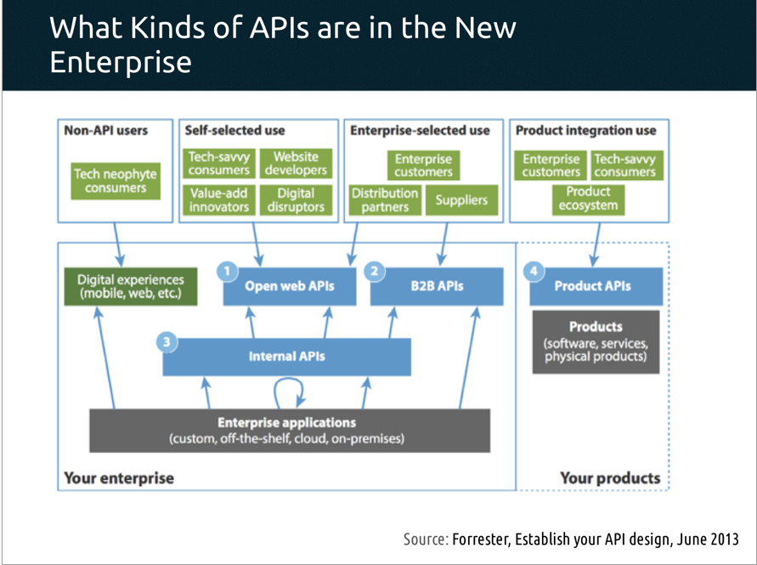

Slide 24
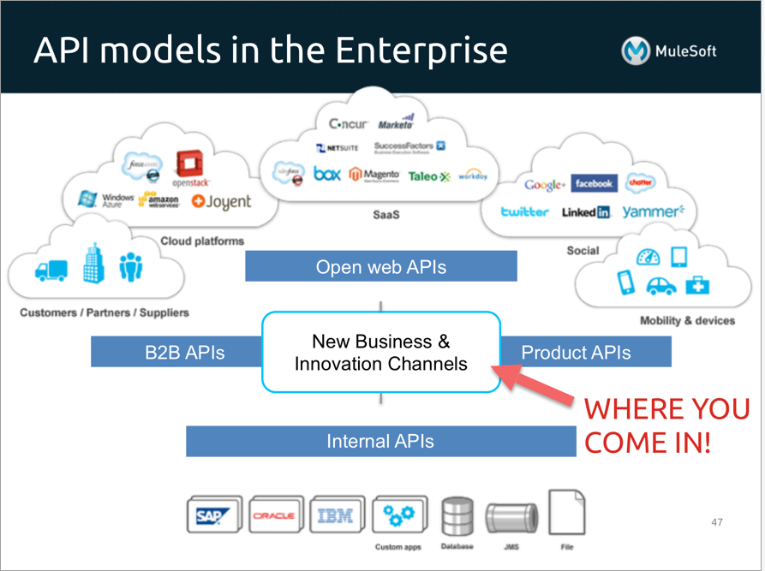
Much of this appears to be independent of the cloud and –as-a-Service, but …
Internal is a statement of ownership, not deployment.
The gateway/boundary
Is logical.
May be a cloud service.
API economy is about
Finding APIs.
Consuming APIs.
Composing APIs.
Publishing APIs.

Slide 25
API Gateway

Slide 26
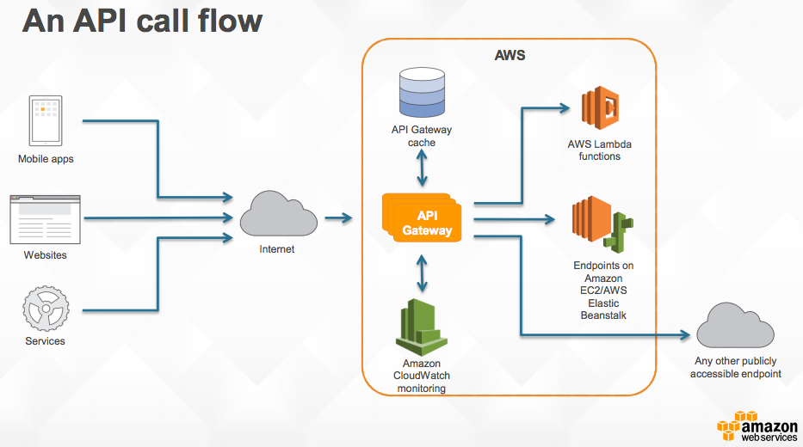
API Gateway

Slide 27
Authorization

Slide 28
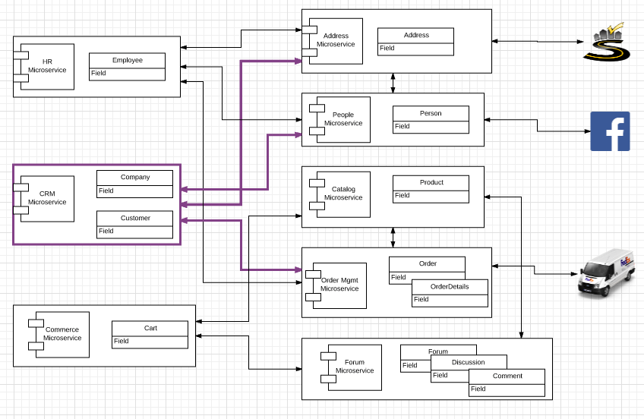

Slide 29
Step Functions

Slide 30
Workflow Orchestration

Slide 31
Workflow/Orchestration
“A workflow consists of an orchestrated and repeatable pattern of business activity enabled by the systematic organization of resources into processes that transform materials, provide services, or process information.^{[1]} It can be depicted as a sequence of operations, declared as work of a person or group,^{[2]} an organization of staff, or one or more simple or complex mechanisms.” (https://en.wikipedia.org/wiki/Workflow)
“Cloud computing introduces more-granular and specific meanings of the terms "workflows" and "processes" as used in different domains. Processes can be identified at both the level of inter-company business and the level of wide area network ("the cloud") operations. An "orchestrator" is understood to be the entity which manages complex cross-domain (system, enterprise, firewall) processes and handles exceptions. Since an orchestrator is valuable in fulfillment, assurance, and billing processes,^{[4]} service-aware incarnations of an orchestrator should be capable of adjustments based on feedback from monitoring tools. At the most basic level, an orchestrator is a human.” (https://en.wikipedia.org/wiki/Orchestration_(computing))

Slide 32
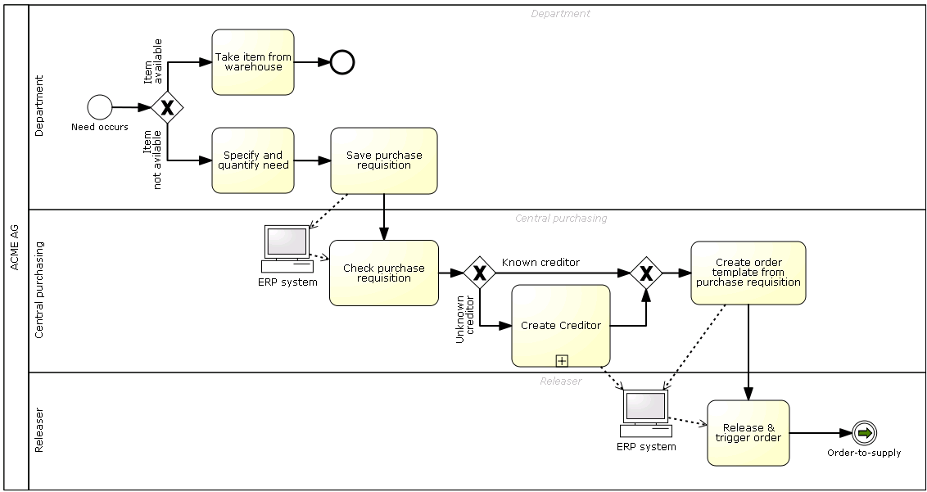
Simple BPMN Diagram

Slide 33
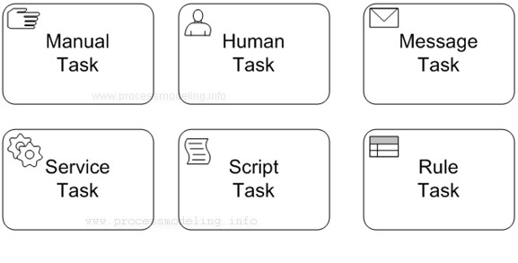
BPMN – How do you Implement?
Send an email.
POST a document
etc.
Notify a person/role.
Have them do something.
Have the use an app that calls the engine to tell you they are done.
Decision table
Call Drools
etc.
Insert into a DB
Call a web service
Run a Java app.
etc.
Run some JavaScript or Java or …
Right at this point in the workflow/process
And manipulate the data/documents/control.

Slide 34
Modeling/Pictures (an aside) https://www.nomagic.com/getting-started/modeling-benefits

Slide 35
Modeling/Pictures (an aside) https://www.nomagic.com/getting-started/modeling-benefits

Slide 36
Step Functions (Introduction)

Slide 37
AWS Step Functions (https://aws.amazon.com/step-functions/)

Slide 38
Execute and Monitor

Slide 39
Simple Example

Slide 40
Simple Example

Slide 41
Concepts

Slide 42
Tasks and Activities

Slide 43
Publish Subscribe

Slide 44
Publish/Subscribe (Wikipedia)
“In software architecture, publish–subscribe is a messaging pattern where senders of messages, called publishers, do not program the messages to be sent directly to specific receivers, called subscribers, but instead categorize published messages into classes without knowledge of which subscribers, if any, there may be. Similarly, subscribers express interest in one or more classes and only receive messages that are of interest, without knowledge of which publishers, if any, there are.
Publish–subscribe is a sibling of the message queue paradigm, and is typically one part of a larger message-oriented middleware system. Most messaging systems support both the pub/sub and message queue models in their API, e.g. Java Message Service (JMS).
This pattern provides greater network scalability and a more dynamic network topology, with a resulting decreased flexibility to modify the publisher and the structure of the published data.”

Slide 45
Publish/Subscribe

Slide 46
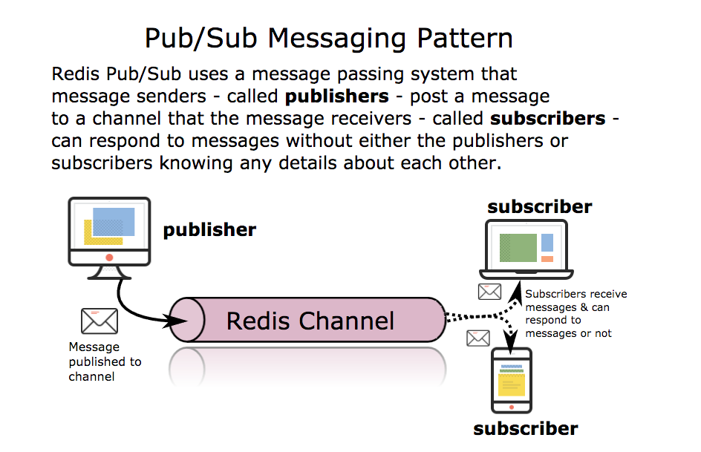
Redis Example

Slide 47
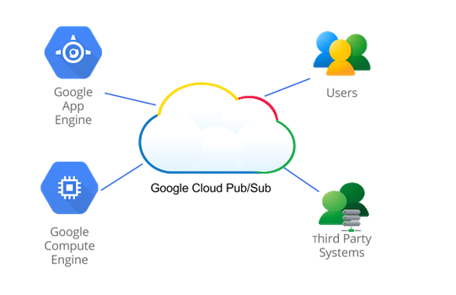
Google Cloud Pub/Sub
https://cloud.google.com/pubsub/overview

Slide 48
SNS

Slide 49
API and Demo
Walkthrough and Demo

Slide 50
Message Queue

Slide 51
Message Queueing (Wikipedia)
“Message queues provide an asynchronous communications protocol, meaning that the sender and receiver of the message do not need to interact with the message queue at the same time. Messages placed onto the queue are stored until the recipient retrieves them. Message queues have implicit or explicit limits on the size of data that may be transmitted in a single message and the number of messages that may remain outstanding on the queue.
… …
There are often numerous options as to the exact semantics of message passing, including:
Durability - messages may be kept in memory, written to disk, or even committed to a DBMS if the need for reliability indicates a more resource-intensive solution.
Security policies - which applications should have access to these messages?
Message purging policies - queues or messages may have a "time to live"
Message filtering - some systems support filtering data so that a subscriber may only see messages matching some pre-specified criteria of interest
Delivery policies - do we need to guarantee that a message is delivered at least once, or no more than once?
Routing policies - in a system with many queue servers, what servers should receive a message or a queue's messages?
Batching policies - should messages be delivered immediately? Or should the system wait a bit and try to deliver many messages at once?
Queuing criteria - when should a message be considered "enqueued"? When one queue has it? Or when it has been forwarded to at least one remote queue? Or to all queues?
Receipt notification - A publisher may need to know when some or all subscribers have received a message.

Slide 52
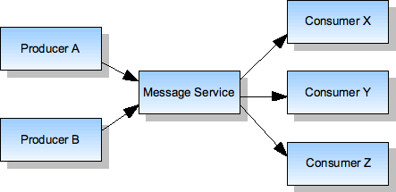
Message Queue Service Pattern
Anti-Pattern
Best Practice Pattern
X
A
Y
B
Z
Point-to-Point communication between modules becomes fragile at scale
Adding modules P and Q requires finding and configuring all senders.
I want to send M to any one of X1, X2 and X3, but only one.
I want to make sure that someone processes M but do not want to hold the transaction until I get a response (I may not even need the response).
My destinations are not “up” at the same times I am.

Slide 53
SQS http://www.slideshare.net/sandipkchaudhari/sqs-and-loose-coupling-presentation
Queue Operations
Create Q
Delete Q
Send Message
Receive Message
Delete Message
FIFO Semantics
Strict, limited scalability.
Best effort, highly scalable.
Transactional

Slide 54
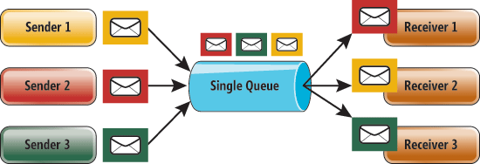
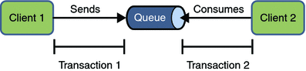
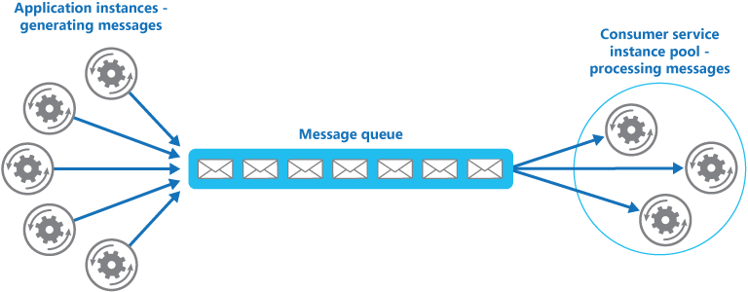
Message Exchange Patterns

Slide 55
Why Would I Use a Queue http://www.javacodegeeks.com/2013/06/working-with-amazon-simple-queue-service-using-java.html is one example)
Flow control
My server may be able to process 100 reqs/second
There are thousands of clients
The aggregate rate could be 10 req/s or 300 req/s
Without a queue, clients would get connect failures under load
The request is going to take a long time
Image reformatting and tagging
I cannot have my code “wait” for a response
And I do not want to write a lot of “Is it done yet?” calls
I do not know (or care) which one implements the logic
I have 5 – 10 image processors for GIFs
I have 7 – 10 processors for .wav files
I do not want to know which ones are active, when and processing what.
I just want to put the “thing in a queue” knowing that someone will eventually pick it up.
Think “email” for API calls

Slide 56
Amazon SQS – Example

Slide 57
API and Demo

Slide 58
API Gateway

Slide 59
Project 1 Review Schedule

Slide 60
Implementing Routing Paths

Slide 61
Overview

Slide 62
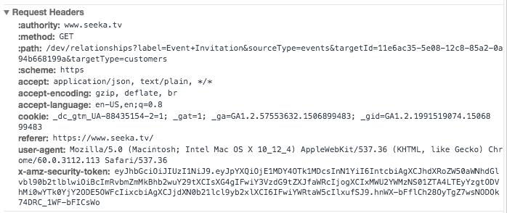
Headers (Path and JWT in Example)

Slide 63
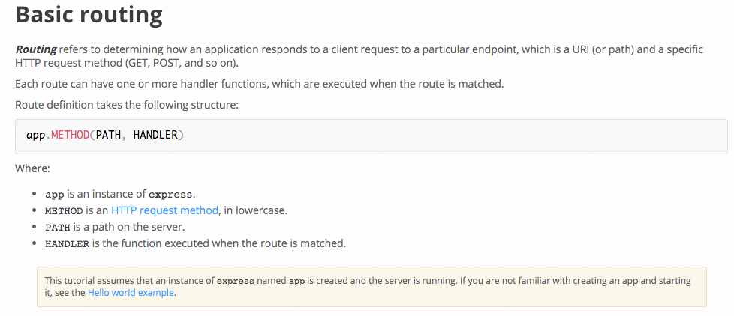
Microservices Maps Method/Paths to Handlers (Example – Node + Express: https://expressjs.com/en/starter/basic-routing.html)
Normalize
Task/Task Command
BO
DO

Slide 64
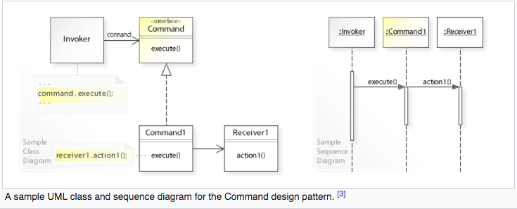
Command/Task Pattern
In the terminology we have been using,
The Command is the Task connecting the composing/routing environment
To the Receiver BO or Proxy for executing the composition/environment independent application logic.

Slide 65
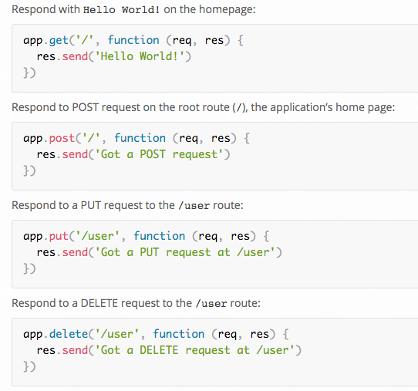
Microservices Maps Method/Paths to Handlers (Node + Express Example; https://expressjs.com/en/starter/basic-routing.html)
These are trivial examples
Instead of inline implementation code, the route call
Normalize the input.
Call XXXBO module via
Some exported function.
The XXXBO.method
Implements the application logic.
Interact with the DO layer.
Returns the normalized answer
The route handler converts to correct response format and protocol.

Slide 66
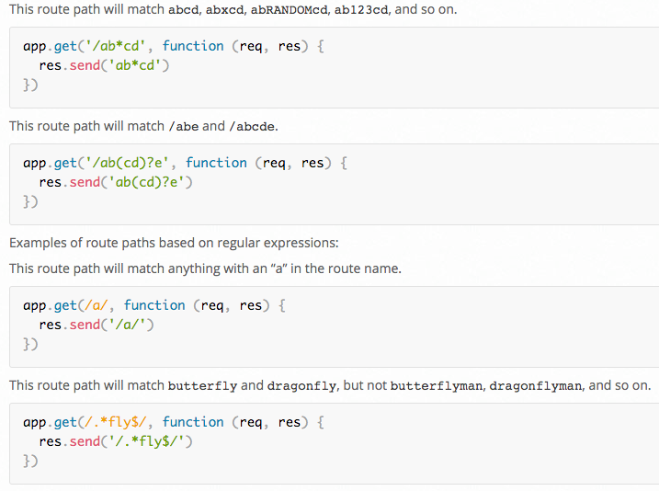
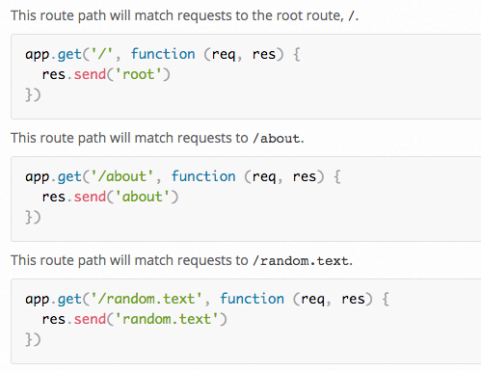
Some Examples

Slide 67
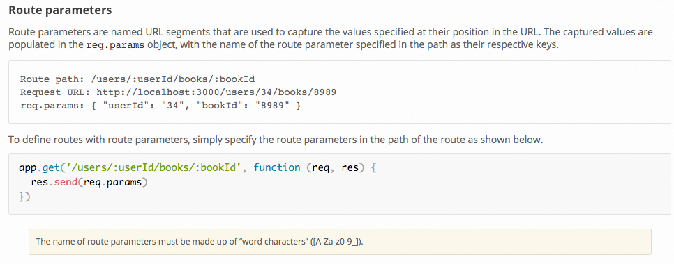
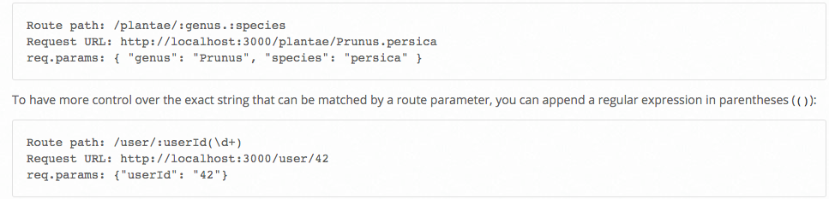
Route/Path Parameters

Slide 68
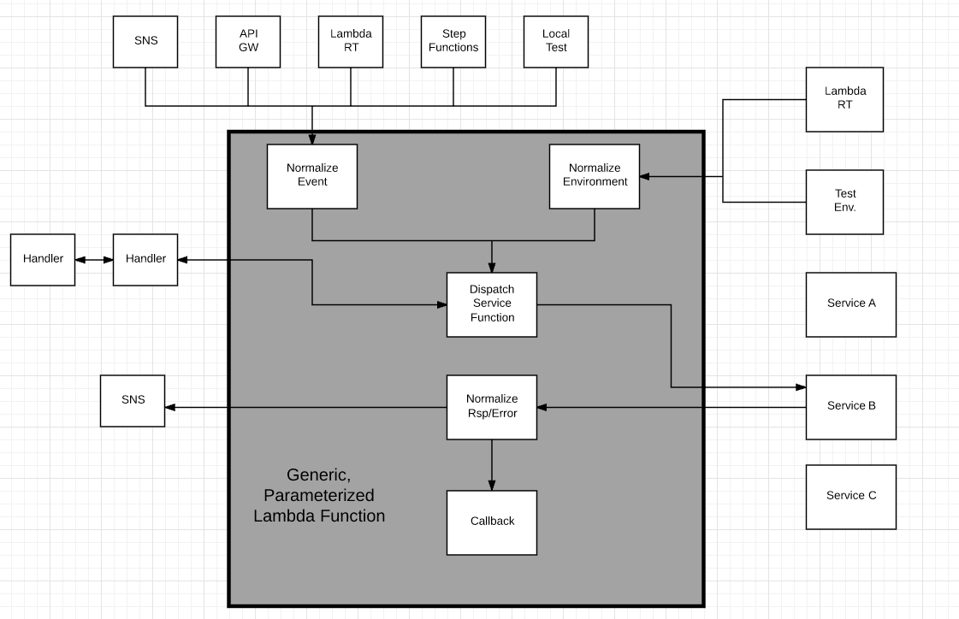
Design Pattern – Generic Lambda Function
Options
In zip file
Separate Lambda
Config info
Added to Lambda
Env Variable
From S3

Slide 69
Project 1 Implications

Slide 70
1st Project – Part 1
Implement two distinct microservices
Person
Address
Tasks
Use Swagger Editor to define and document REST APIs.
Implement an Elastic Beanstalk application (microservice) for each resource that implements the relevant REST API.
Each microservice should support
GET and POST on resource, e.g. /Person
GET, PUT, DELETE on resource/id, e.g. /Person/dff9
Simple query, e.g. /Person?lastName=Ferguson
Pagination
Relationship paths: /Person/dff9/address and /Addresses/someID/persons
HATEOAS links where appropriate.
Simple HTML/Angular demo UI.
Due: 11:59 PM on 26-Sep-2017
How could this work?
There are two distinct microservices, but these URLs reference both.

Slide 71
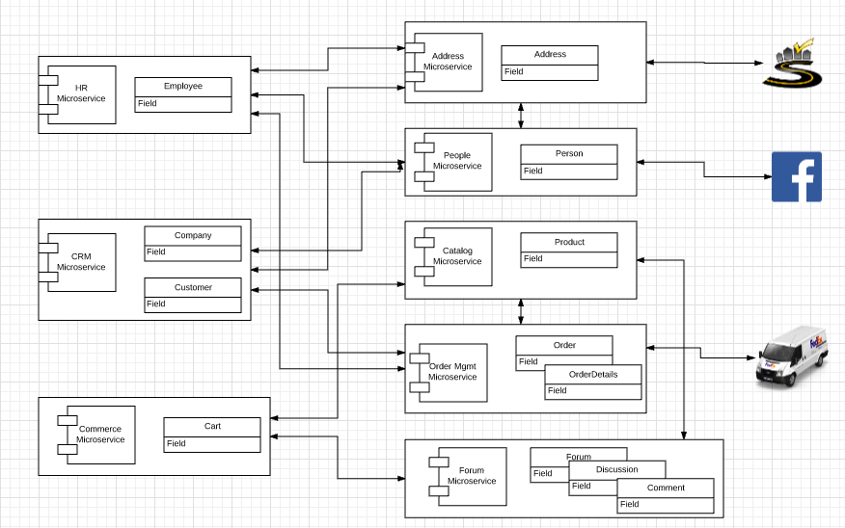
Microservice Model
“Why is this thus, and what is the reason for this thus-ness?”

Slide 72
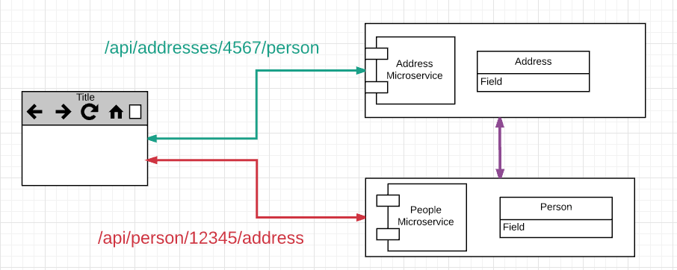
Microservice – Microservice Interactions
Microservices interact to process methods/operations.
These two examples are relatively simple. For example, GET /person/1234/address
Command/call to retrieve /person/1234 via local BO/DO.
Access address link.
Command/call to “GET” on address link via Proxy
Return requested information
Which is basically the same approach as implementing in the UI.

Slide 73
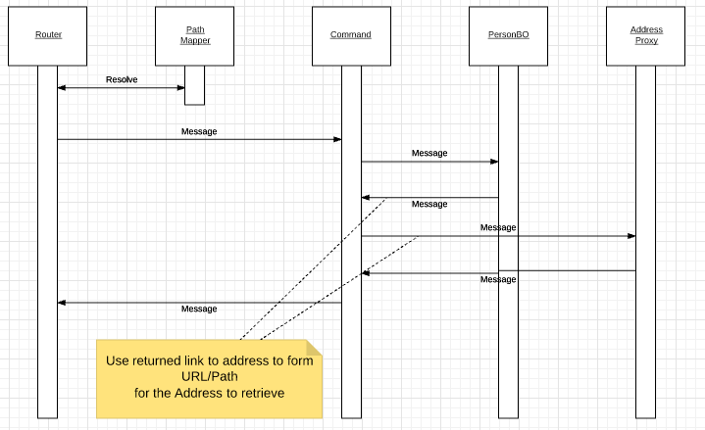
GET /Person/1234/address

Slide 74
GET /Person/1234/address
/addresses/4567/person is similar but simpler
Do not need to retrieve Address 4567
Simply
Invoke the Person proxy specifying
/person?address=4567
Several options for how you handle a property that is both
A value
A link

Slide 75
Path Summary

Slide 76
Path Summary
The slides express the concepts in very systematic terms
Path Router
Command/Task
BO, DO
etc.
There are frameworks and models that are very rigorous about the concepts, but much/most of the time you
Think with the concept in your mind.
Implement in relatively simple code.
The key takeaways are:
REST API users expect to be able to follow paths.
Microservices interact to implement operations.
Microservice implementation needs to implement mapping paths to specific code.

Slide 77
Idempotency Safe Methods Conditional Execution

Slide 78
Idempotent Safe

Slide 79
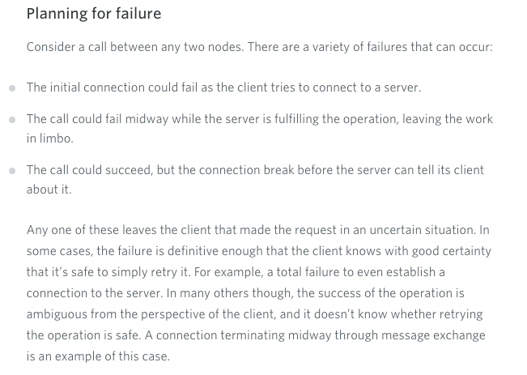
Client and Server Must Plan for Call Failure
https://www.safaribooksonline.com/library/view/restful-web-services/9780596809140/ch01s04.html

Slide 80
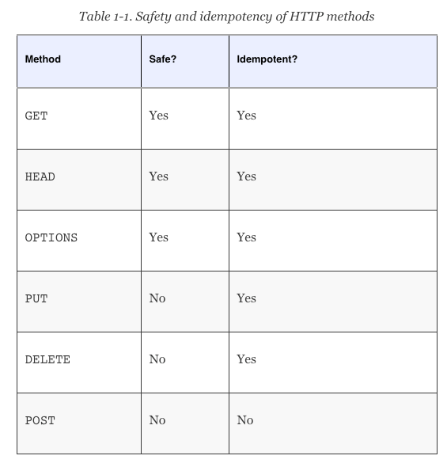
Idempotent and Safe
“Idempotence is the property of certain operations in mathematics and computer science that they can be applied multiple times without changing the result beyond the initial application.” (Wikipedia)
“In particular, the convention has been established that the GET and HEAD methods SHOULD NOT have the significance of taking an action other than retrieval. These methods ought to be considered "safe". This allows user agents to represent other methods, such as POST, PUT and DELETE, in a special way, so that the user is made aware of the fact that a possibly unsafe action is being requested.
Naturally, it is not possible to ensure that the server does not generate side-effects as a result of performing a GET request; in fact, some dynamic resources consider that a feature. The important distinction here is that the user did not request the side-effects, so therefore cannot be held accountable for them.” https://www.w3.org/Protocols/rfc2616/rfc2616-sec9.html
https://www.safaribooksonline.com/library/view/restful-web-services/9780596809140/ch01s04.html

Slide 81
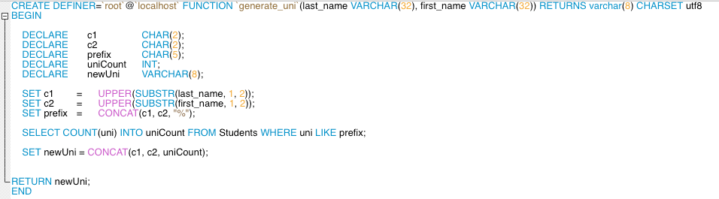
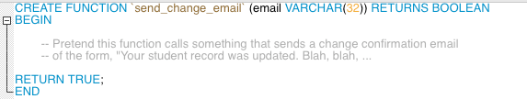
Well, That was Vaguely Alarming Well, Consider a Student Table

Slide 82
Well, That was Vaguely Alarming Well, Consider a Student Table
INSERT is not idempotent.
Calling “INSERT INTO Students (last_name, first_name, email) VALUES (“Smith”, “John”, “js@contoso.com”);
3 times results in 3 tuples for the same person
UPDATE is idempotent but not “safe.”
Calling “UPDATE Students SET “email=js23@columbia.edu” WHERE uni=“JS01”;
3 times has the same end state for the tuple as one call
BUT sends 3 annoying emails (side effects).
SELECT
Does not change the data and does not send an email, and is idempotent and safe (probably).
Multiple SELECTs may not return the same result. Someone else may have changed the tuple.
DELETE
Multiple deletes have the same result (record deleted), but 2, 3, … probably return a different result.
May or may not have side effects.

Slide 83
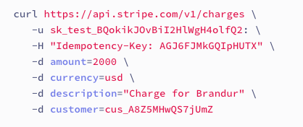
Implementing Idempotency (Consider Stripe.com)
Requests have a caller generated
UUID
Stored in a header.
The Microservice
Check if the message is “too old.”
Checks a ledger for the header.
Return the previously recorded response if found.
Otherwise
BEGIN TRANSACTION
Record idempotency header.
Change resource.
Generate response.
Record response.
COMMIT
Return response.
Periodically purge the ledger of old headers.
This is a conceptual explanation.
Many implementations do not use transactions and a implement a best effort, except when extremely critical.

Slide 84
Read then Update Conflict
Some
Resource
1. Bob GETs the resource.
3. Bob changes the data based on values.
2. Mary GETs the resource.
If
The written value
Depends on the read value.
The resource may be in the wrong state and the end.
The execution was RRWW
But the intent was RWRW.
4. Mary changes the data based on values.

Slide 85
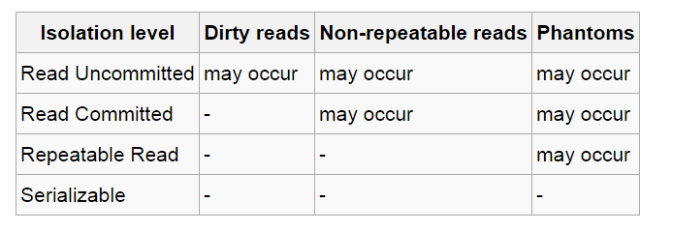
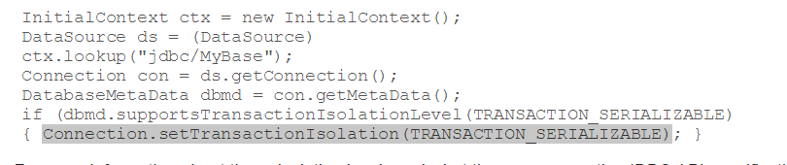
In Databases, Cursors Define Isolation
We have talked about ACID transactions
Atomic: A set of writes all occur or none occur.
Durable: The data “does not disappear,” e.g. write to disk.
Consistent: My applications move the database between consistent states, e.g. the transfer function works correctly.
Isolation
Determines what happens when two or more threads are manipulating the data at the same time.
And is defined relative to where cursors are and what they have touched.
Because the cursor movement determines what you are reading or have read.
But, … Cursors are client conversation state and cannot be used in REST.

Slide 86
Isolation/Concurrency Control
There are two basic approaches to implementing isolation
Locking/Pessimistic, e.g. cursor isolation
Optimistic: Before committing, each transaction verifies that no other transaction has modified the data it has read.
How does this work in REST?
The server maintains an ETag (Entity Tag) for each resource.
Every time a resource’s state changes, the server computes a new ETag.
The server includes the ETag in the header when returning data to the client.
The server may optionally maintain and return “Last Modified” time for resources.
Semantics on updates
If-Match – value of a previous calls ETag response used with a PUT or DELETE. Server should only act if nobody else has modified the resource since you last fetched it. Otherwise provides a 412.
If-Modified-Since – value of a previous Last-Modified response used with a GET. Server should only provide a response if the resource was modified since the timestamp submitted. Use in conjunction with If-None-Match in case the change occurred within the same second. Otherwise provide a 304.
If-None-Match – value of a previous calls ETag response used with a GET. Server should only provide a response if the ETag doesn’t match, i.e. the resource has been altered. Otherwise provide a 304.
If-Unmodified-Since – value of a previous Last-Modified response used with a PUT or DELETE. Server should only act if nobody else has modified the resource since you last fetched it. Otherwise provides a 412

Slide 87
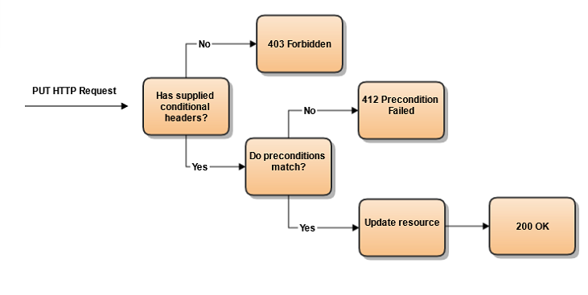
Conditional Processing (https://blog.4psa.com/rest-best-practices-managing-concurrent-updates/)

Slide 88
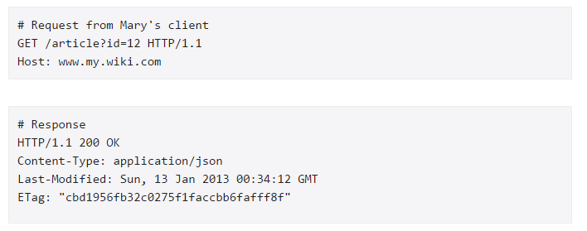
Request/Response

Slide 89
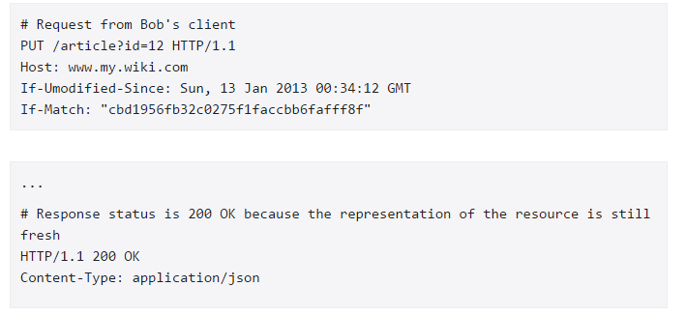
Bob Already Read and now Updates
In addition to updating the resource state, e.g. account balance, this also changes
The ETag
The Last Modified Date

Slide 90
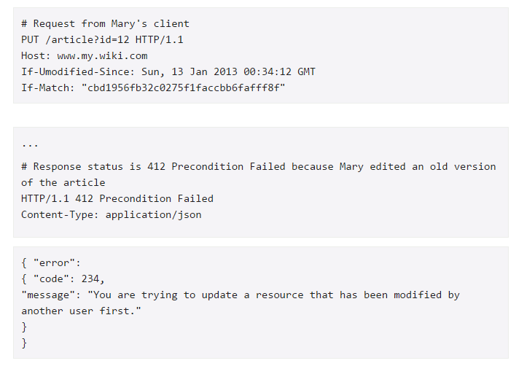
Now Mary Tries to Update
Bob’s update changed the data, and changed this “metadata.”

Slide 91
Middleware

Slide 92
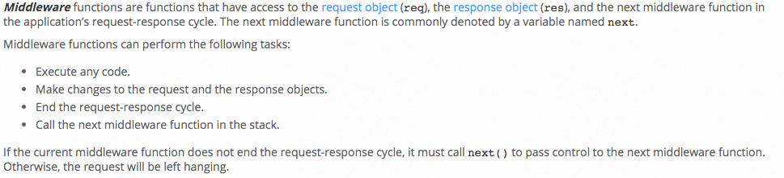
Middleware
“Middleware is computer software that provides services to software applications beyond those available from the operating system. It can be described as "software glue".^{[1]}
Middleware makes it easier for software developers to implement communication and input/output, so they can focus on the specific purpose of their application.” (Wikipedia)

Slide 93
Middleware
“Middleware is computer software that provides services to software applications beyond those available from the operating system. It can be described as "software glue".^{[1]}
Middleware makes it easier for software developers to implement communication and input/output, so they can focus on the specific purpose of their application.” (Wikipedia)
Don’s definition
The is application specific logic.
Icky, complex stuff that all applications seems to need
Transactions
Security
etc.
This is the middleware.
There are parts two middleware
What gets injected into the application code, often before and after processing.
The API or service implementing the function.

Slide 94



Node Express Express Example
Call local or cloud infrastructure APIs

Slide 95

Apache Axis Example
The before and after handlers/middleware interceptors
May perform inline processing of request, e.g. validate signature and/or
May call an external service API, e.g. logging, check an ETag in a ledger, etc.

Slide 96
Project

Slide 97
Project 2

Slide 98

Project 2 – Part 1
Build on 1st to microservices
Implement the CRM Service (and HR Service) using Lambda functions, and orchestration approach from previous lecture.
Integrate with SmartyStreets
Deploy all 3 microservices via API Gateway.
Deliver web content via CloudFront and S3.

Slide 99
Project 2 – Part 2
Implement middleware plugins and microservices implementing
ETag generation and processing.
Idempotent functions.
SNS Event generation on PUT, POST and DELETE.
Plug/deploy the plugin layer in
Each of the Beanstalk Microservices
The CRM Lambda function.
Write an empty, placeholder Lambda function that reacts to the SNS events. We will do some interesting things with this later.

